Slide 1
Machine Learning

Slide 2
Objectives
1) What is Learning?
2) What is Machine Learning?
3) Steps in machine learning.
4) Types of machine Learning.
5) Applications of Machine Learning.

Slide 3
What is Learning?
  “To gain knowledge or understanding of, or skill in by study, instruction or experience''
    Learning a set of new facts.
    Learning HOW to do something .
    Improving ability of something already learned.

Slide 4
What is Machine Learning?
Machine Learning is the study of methods for programming computers to learn.
Building machines that automatically learn from experience.
Machine learning usually refers to the changes in systems that perform tasks associated with artificial intelligence AI Such tasks involve recognition, diagnosis, planning, robot control, prediction, etc.

Slide 5
What is Machine Learning?
Learning
algorithm
Trained
machine
TRAINING
DATA
Answer
?
Query

Slide 6
Steps in machine learning
Data collection.
Representation.
Modeling.
Estimation.
Validation.
Apply learned model to new “test” data

Slide 7
General structure of a learning system
Learning system
Data
Learning
Process
Feed-back
Problem Solving
Teacher
Results
Performance
Evaluation

Slide 8
Advantages of ML
Solving vision problems through statistical inference.
Intelligence from the common sense AI.
Reducing the constraints over time achieving complete autonomy.

Slide 9
Disadvantages of ML
Application specific algorithms.
Real world problems have too many variables and sensors might be too noisy.
Computational complexity.

Slide 10
Types of machine Learning
1) Unsupervised Learning .
2) Semi-Supervised (reinforcement).
3) Supervised Learning.

Slide 11
Unsupervised Learning
Studies how input patterns can be represented to reflect the statistical structure of the overall collection of input patterns
No outputs are used (unlike supervised learning and reinforcement learning)
Learner is provided only unlabeled data.
No feedback is provided from the environment

Slide 12
Unsupervised Learning
Advantage
Most of the laws of science were developed through unsupervised learning.
Disadvantage
The identification of the features itself is a complex problem in many situations.

Slide 13
Semi-Supervised (reinforcement)
it is in between Supervised and Unsupervised learning techniques the amount of labeled and unlabelled data required for training.
With the goal of reducing the amount of supervision required compared to supervised learning.
At the same time improving the results of unsupervised clustering to the expectations of the user.

Slide 14
Semi-Supervised (reinforcement)
Semi-supervised learning is an area of increasing importance in Machine Learning.
Automatic methods of collecting data make it more important than ever to develop methods to make use of unlabeled data.

Slide 15
Supervised Learning
1) Analogical Learning.
2) Learning by Decision Tree.

Slide 16
Analogical Learning
instances of a problem and the learner has to form a concept that supports most of the positive and no negative instances. This demonstrates that a number of training instances are required to form a concept in inductive learning. Unlike this, analogical learning can be accomplished from a single example. For instance, given the following training instance, one has to determine the plural form of bacilus.

Slide 17
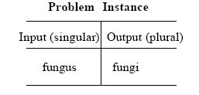
Analogical Learning

Slide 18
The main steps in analogical learning are now formalized below.
1. Identifying Analogy: Identify the similarity between an
experienced problem instance and a new problem.
2. Determining the Mapping Function: Relevant parts of the
experienced problem are selected and the mapping is
determined.
3. Apply Mapping Function: Apply the mapping function to
transform the new problem from the given domain to the target domain.

Slide 19
The main steps in analogical learning are now formalized below.
4. Validation: The newly constructed solution is validated for its applicability through its trial processes like theorem or
simulation .
5. Learning: If the validation is found to work well, the new
knowledge is encoded and saved for future usage.

Slide 20
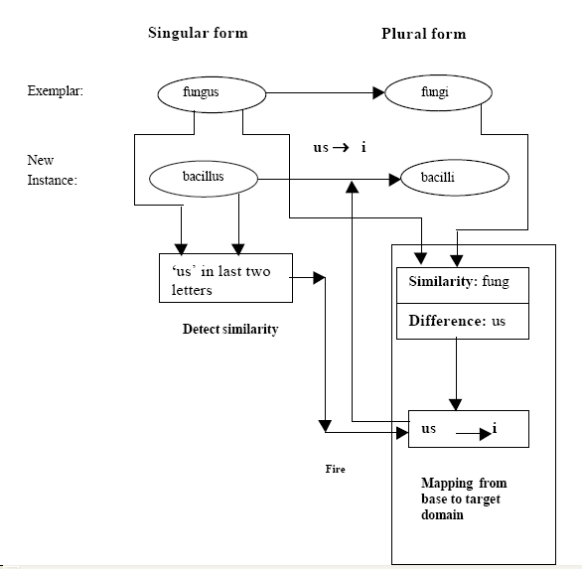

Slide 21
Learning by Decision Tree
A decision tree receives a set of attributes (or properties) of the objects as
inputs and yields a binary decision of true or false values as output. Decision
trees, thus, generally represent Boolean functions. Besides a range of {0,1}
other non-binary ranges of outputs are also allowed. However, for the sake of
simplicity, we presume the restriction to Boolean outputs. Each node in a
decision tree represents ‘a test of some attribute of the instance, and each
branch descending from that node corresponds to one of the possible values
for this attribute’

Slide 22
Learning by Decision Tree
To illustrate the contribution of a decision tree, we consider a set of instances, some of which result in a true value for the decision. Those instances are called positive instances. On the other hand, when the resulting decision is false, we call the instance ‘a negative instance’. We now consider the learning problem of a bird’s flying. Suppose a child sees different instances of birds as tabulated below.

Slide 23
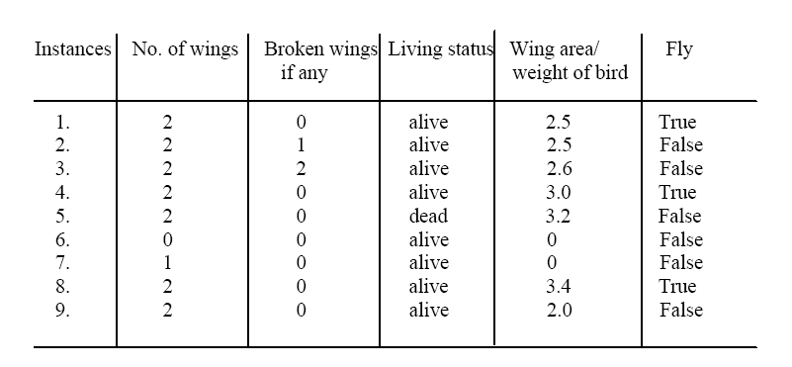
Learning by Decision Tree

Slide 24
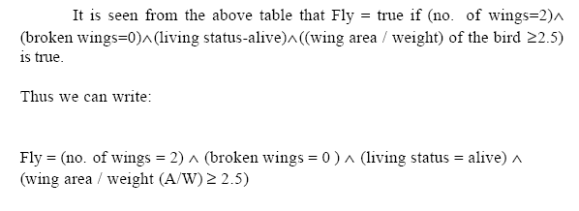
Decision Tree example

Slide 25
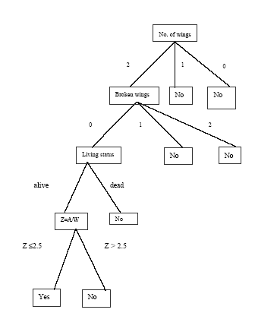
Decision Tree example

Slide 26
Applications
of
Machine Learning

Slide 27

Drug discovery

Slide 28
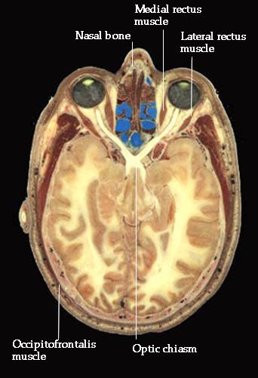
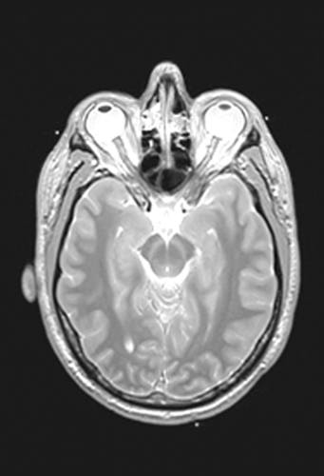
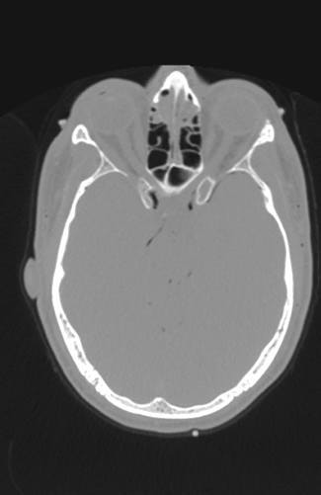
Medical diagnosis
Photo
MRI
CT

Slide 29

Iris verification

Slide 30

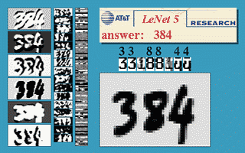
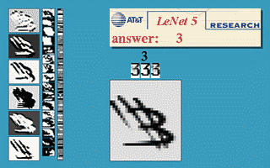
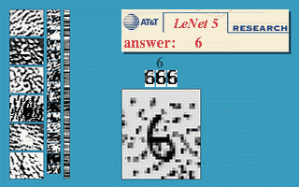

Slide 31
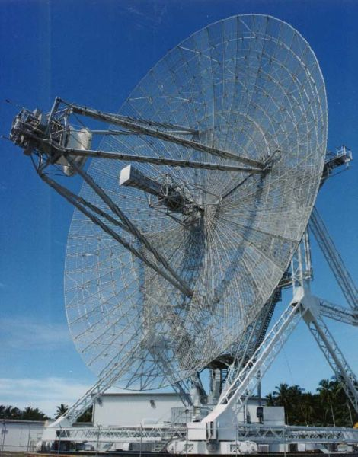
Radar Imaging

Slide 32
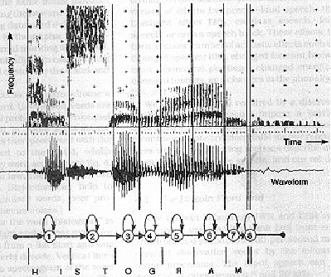
Speech Recognition

Slide 33
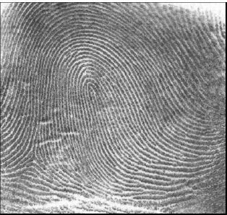
Finger print
fingerprint image

Slide 34

Signature Verification

Slide 35
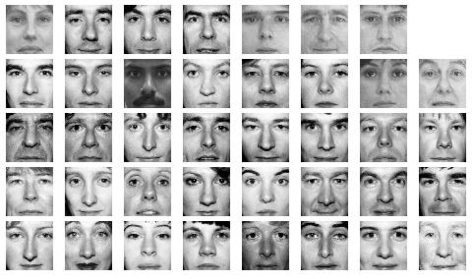
Face Recognition

Slide 36
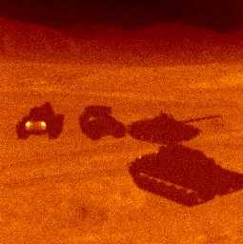

Target Recognition

Slide 37
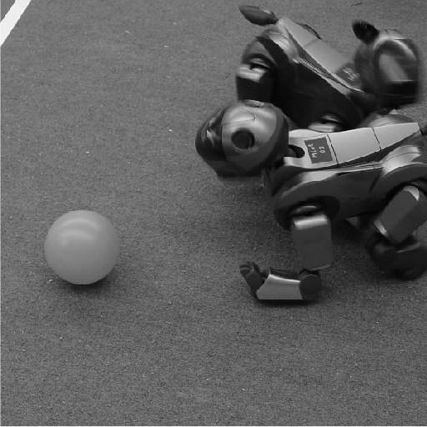
Robotics vision

Slide 38
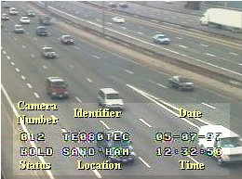
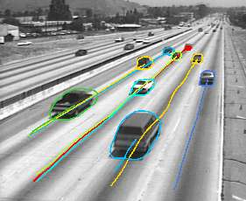
Traffic Monitoring

Slide 39
Thank you

